Slide 1
PERFORMING ARTS
DANCE

Slide 2
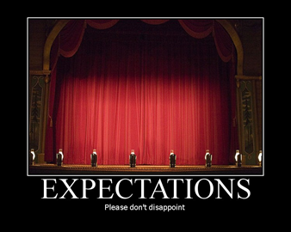

EXPECTATIONS
BE RESPECTFUL OF OTHERS IN THE CLASS.
TRY YOUR HARDEST AT ALL TIMES.
LISTEN TO FEEDBACK AND USE THIS CONSTRUCTIVELY TO IMPROVE YOUR PERFORMANCE.
LISTEN TO THE TEACHER AT ALL TIMES.
BE ABLE TO WORK AS A GROUP AND INDEPENDENTLY.
BE CREATIVE.
USE THE STAGE EFFECTIVELY.
LISTEN TO YOUR PEERS IDEAS

Slide 3
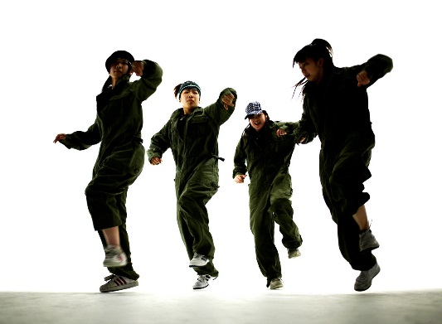
Learning Objective
To be able to:
To self assess the video of your performance.
To receive feedback form the class of your group performance and set targets for improvement as a result.

Slide 4
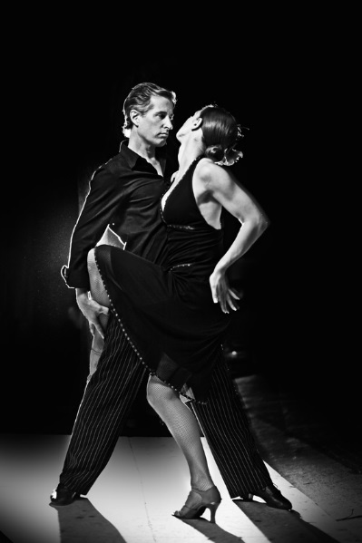
Success Criteria
Step 3
Can focus in the warm and identify some pulse raisers.
Can reproduce the taught routine with a few errors.
Step 4
Will focus and put effort in throughout the lessons and be able to identify the 3 sections of the warm up.
Will perform the routine with energy and focus.
Step 5.
Will concentrate and perform to the best of their ability throughout the lesson and work hard to warm up effectively.
Will perform with focus and accuracy of movement and always be keen to improve.
Step 6
Will be a role model to the group, work hard at all times and be proactive in asking and answering questions.
Will take a leadership role when rehearsing and help others to perform the routine.

Slide 5

SELF ASSESSMENT
You will now watch the Video of last weeks performance.
Give yourself 2 stars and a wish to improve

Slide 6
PEER ASSESSMENT
Listen to the others who watched you.
What feedback have you received?
Create an action plan of how to improve as a result of this.

Slide 7
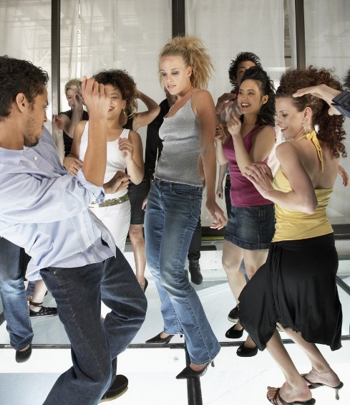
KEY WORDS
Constructive criticism
Target setting
Area for improvement
Key strengths

Slide 8
PLENARY
How do you think you have performed?
What grade do you think you achieved?
What have you decided to do to improve and why?

